Slide 1
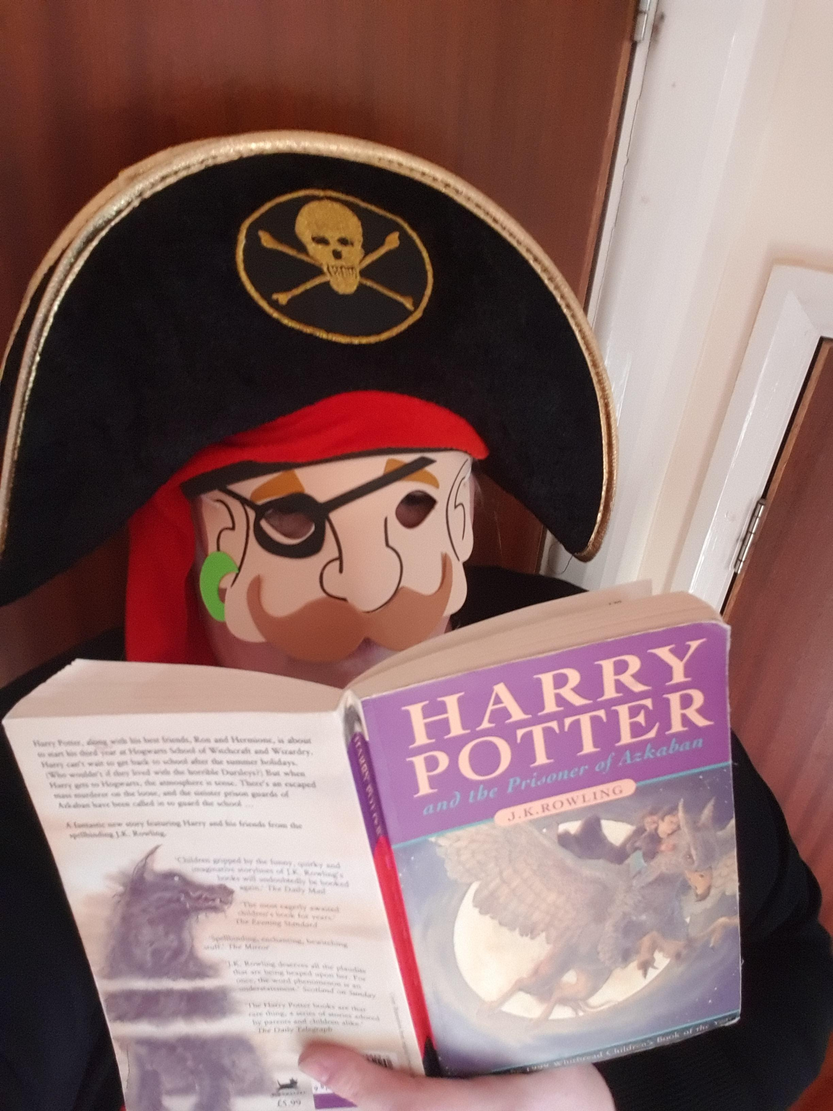
‘Harry Potter and the Prizoner of Azkaban’ by J K Rowling is my favourite children's book because it introduces one of my favourite characters within the world of Harry Potter & it includes wonderful examples of bravery, teamwork, compassion, friendship & justice. I love Harry Potter books!

Slide 2
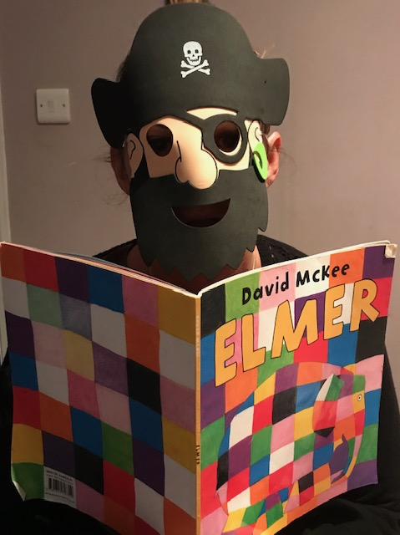
My favourite children’s book is Elmer - I loved reading it to my children and they loved it being read to them.
It teaches you to live happily and be yourself. My children loved to hear it even night after night !

Slide 3
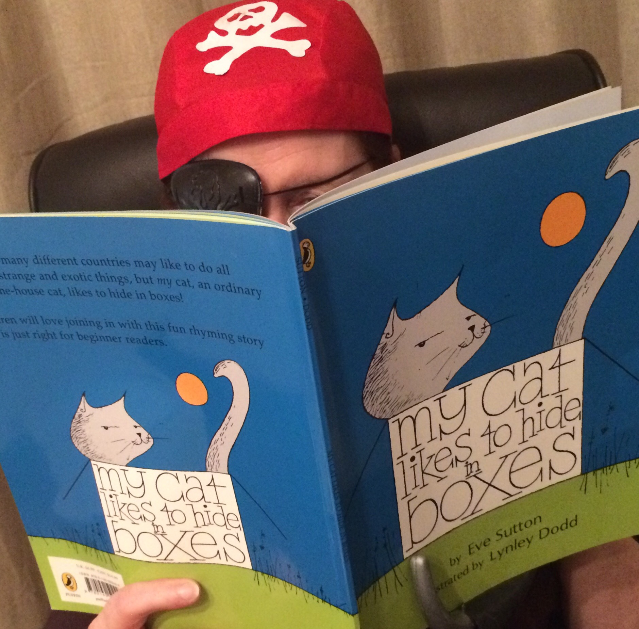
My cat likes to hide in boxes by Eve Sutton is my favourite children's book because it’s great for sharing.
Maybe, I love this book because my cat also likes to hide in boxes!

Slide 4
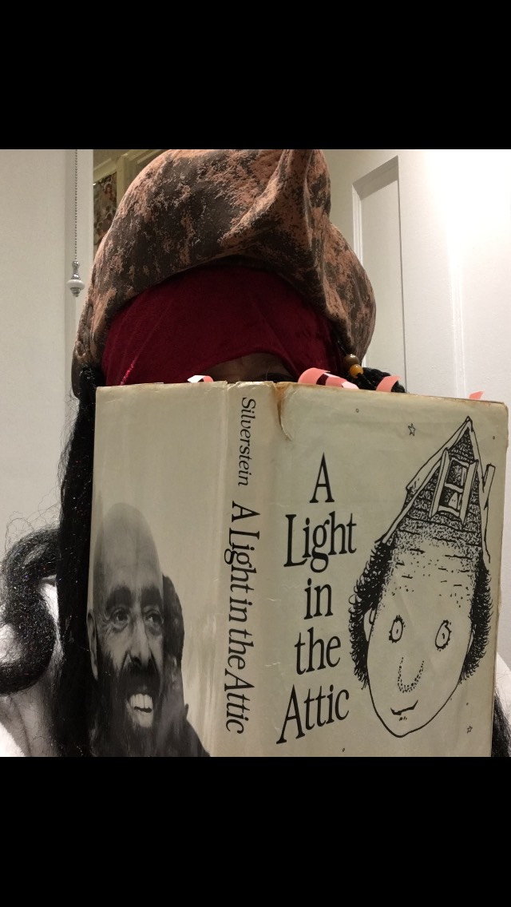
A light in the attic by Shel Silverstein.
This is a poetry book full of mischief and alternative thinking. It has poems for all ages and is a great book for sharing! It also inspires me to make and create!

Slide 5
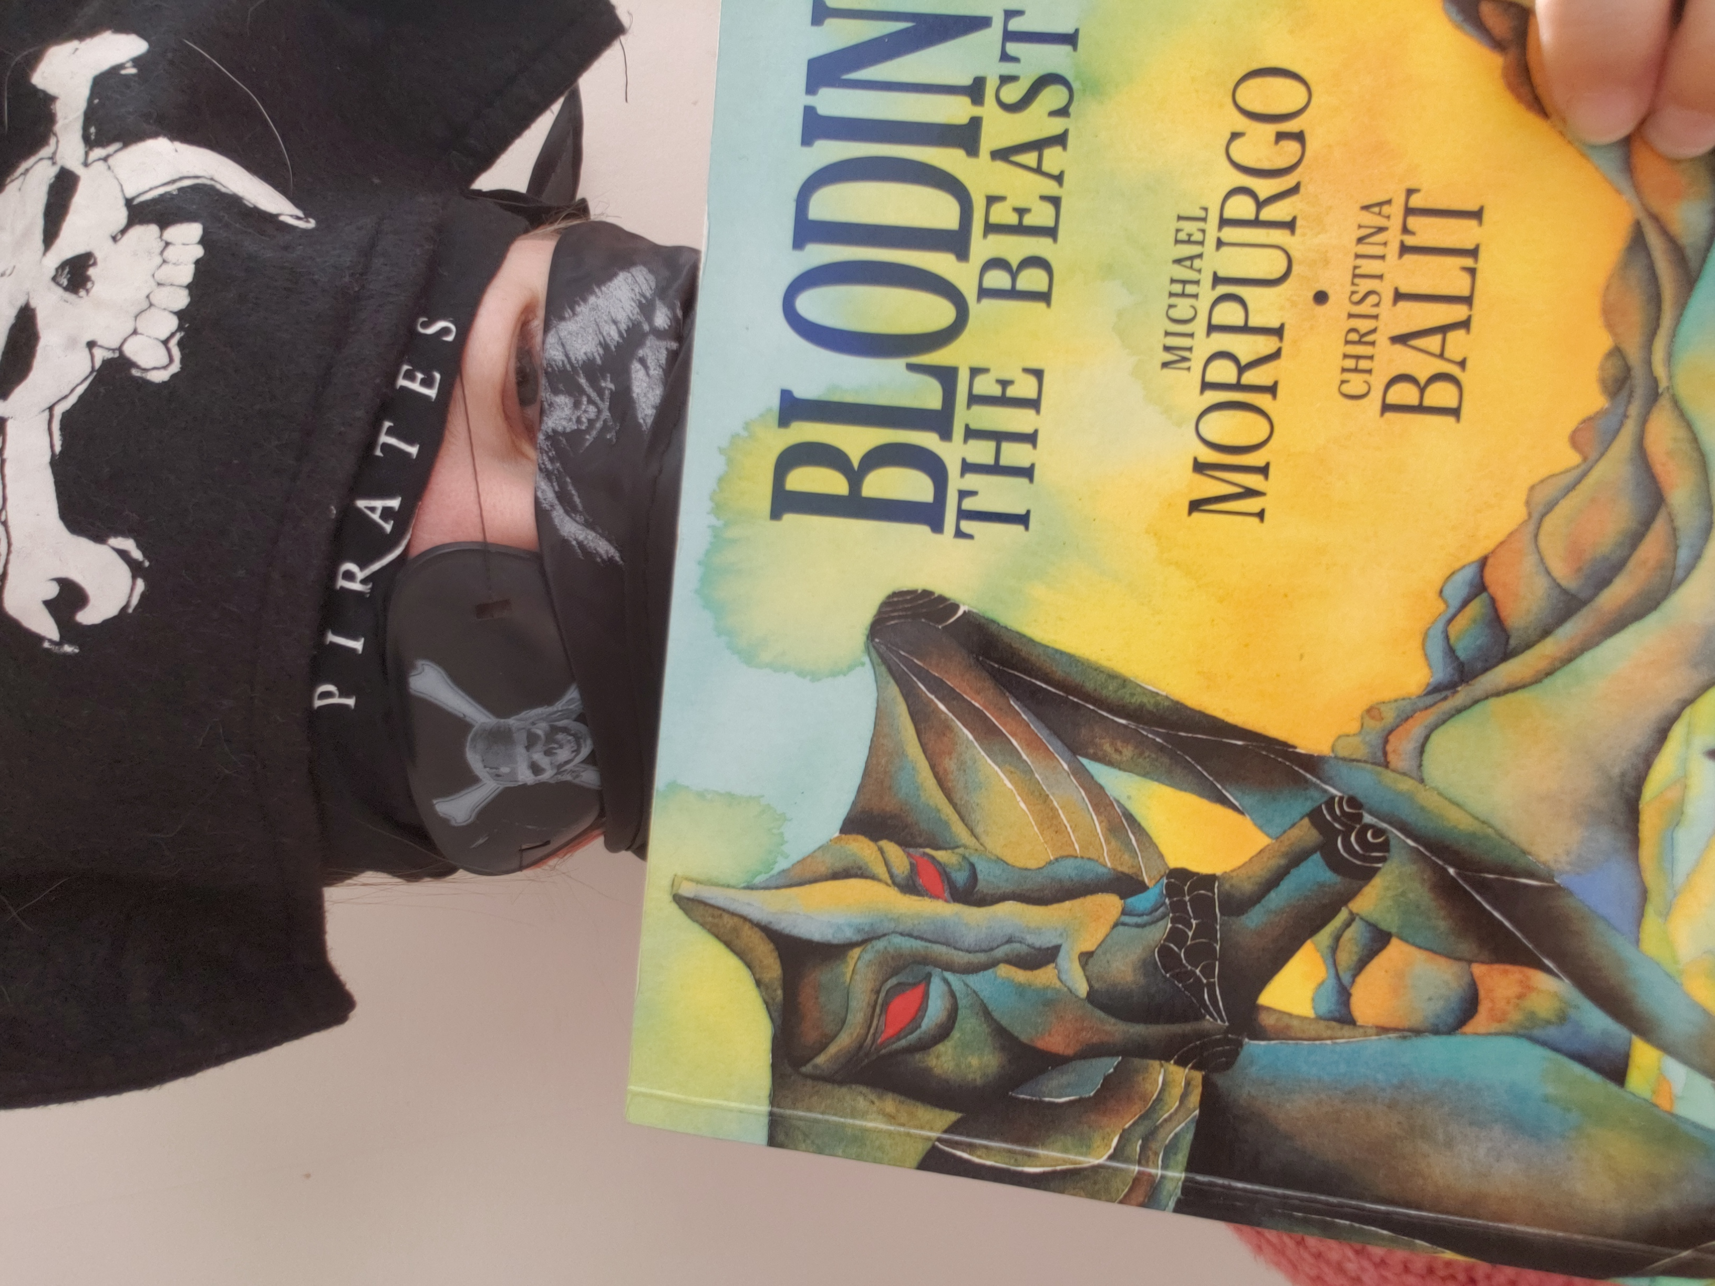
Blodin the Beast stalks the land, breathing fire and turns villages to ruins. This is one the best illustrated books I've ever seen with its amazing watercolour illustrations. I love to paint with water colours

Slide 6
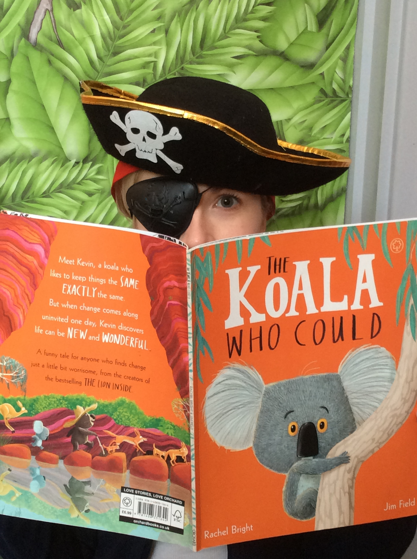
'The Koala who could' is a funny story about a koala called Kevin who is frightened to try new things. But when change comes along uninvited one day, Kevin discovers life can be new and wonderful.

Slide 7
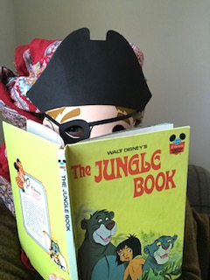
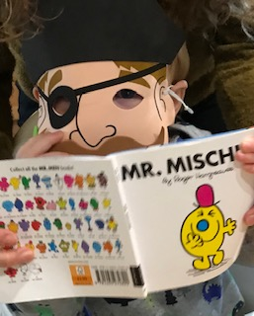
One of my favourite books is ‘The Jungle Book’. It's such a wonderful adventure story with lots of hidden meanings. The story tells us to respect the world we live in and to have fun. It has fabulous songs and I love to sing!
……one of my favourite books is Mr Mischief. I like all the cheeky things he gets up to but I also feel sad for his friends when he plays tricks on them

Slide 8
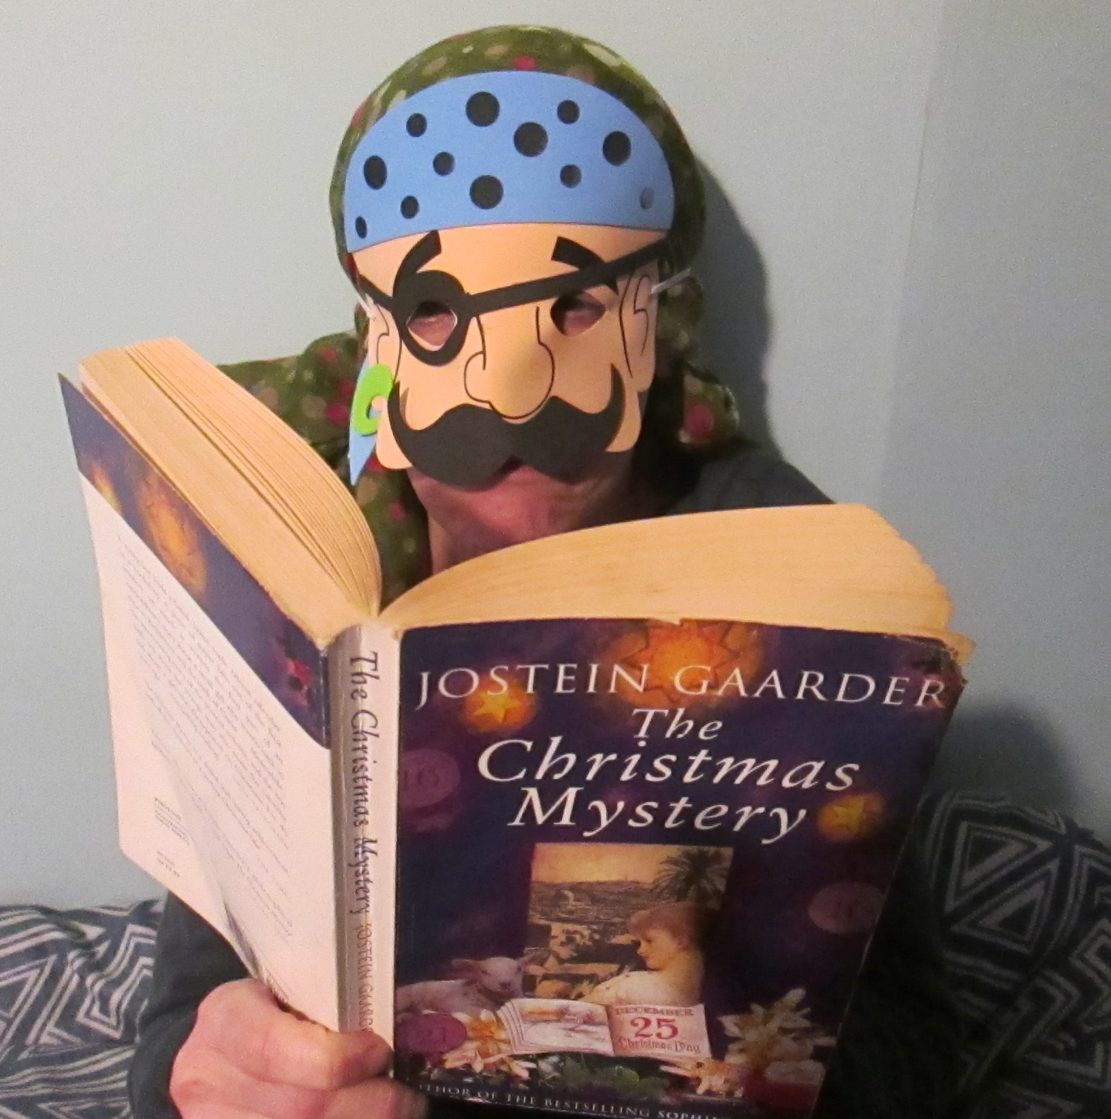
The Christmas Mystery by Jostein Gaarder is my favourite book. It tells the story of a small boy who finds an ancient advent calendar. As each door is opened the mysterious story is revealed day by day. I love this book because paints pictures in your head of the characters and countries you travel through and, just like an advent calendar, there are 24 chapters!

Slide 9
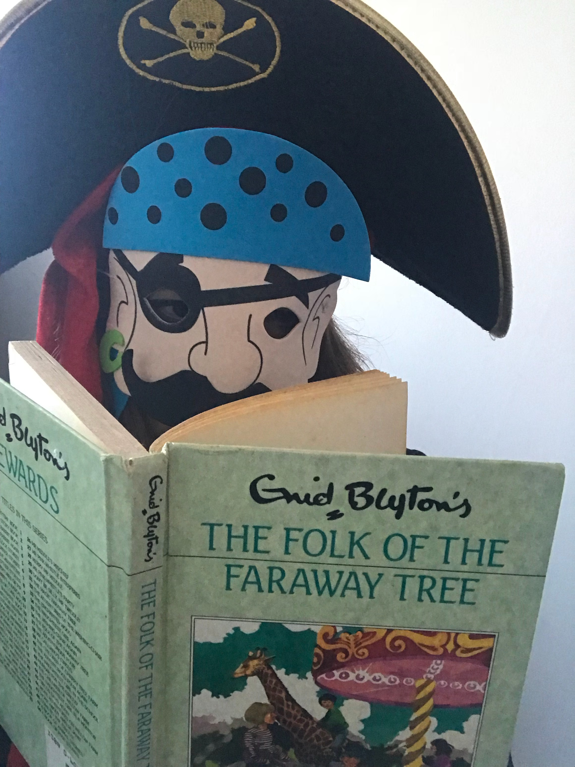
The folk and the Faraway tree was a book that my Grandmother shared with me as a child . I enjoyed the amusing characters and their magical adventures. I wonder if there are any magical characters in the tree in Emerald class…

Slide 10
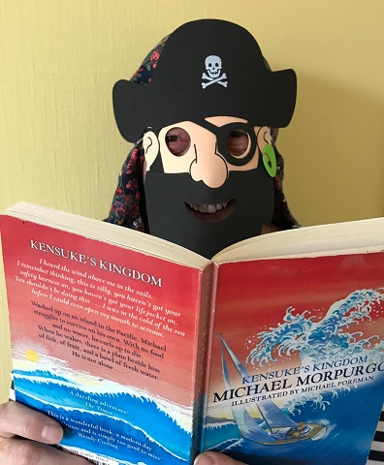
'Kensuke's Kingdom' is an amazing story, with Michael (aged 10) being washed up on a Pacific island to find he is not alone. Is he safe? Will he survive? This story tells you a lot about how brave and resourceful children can be.

Slide 11
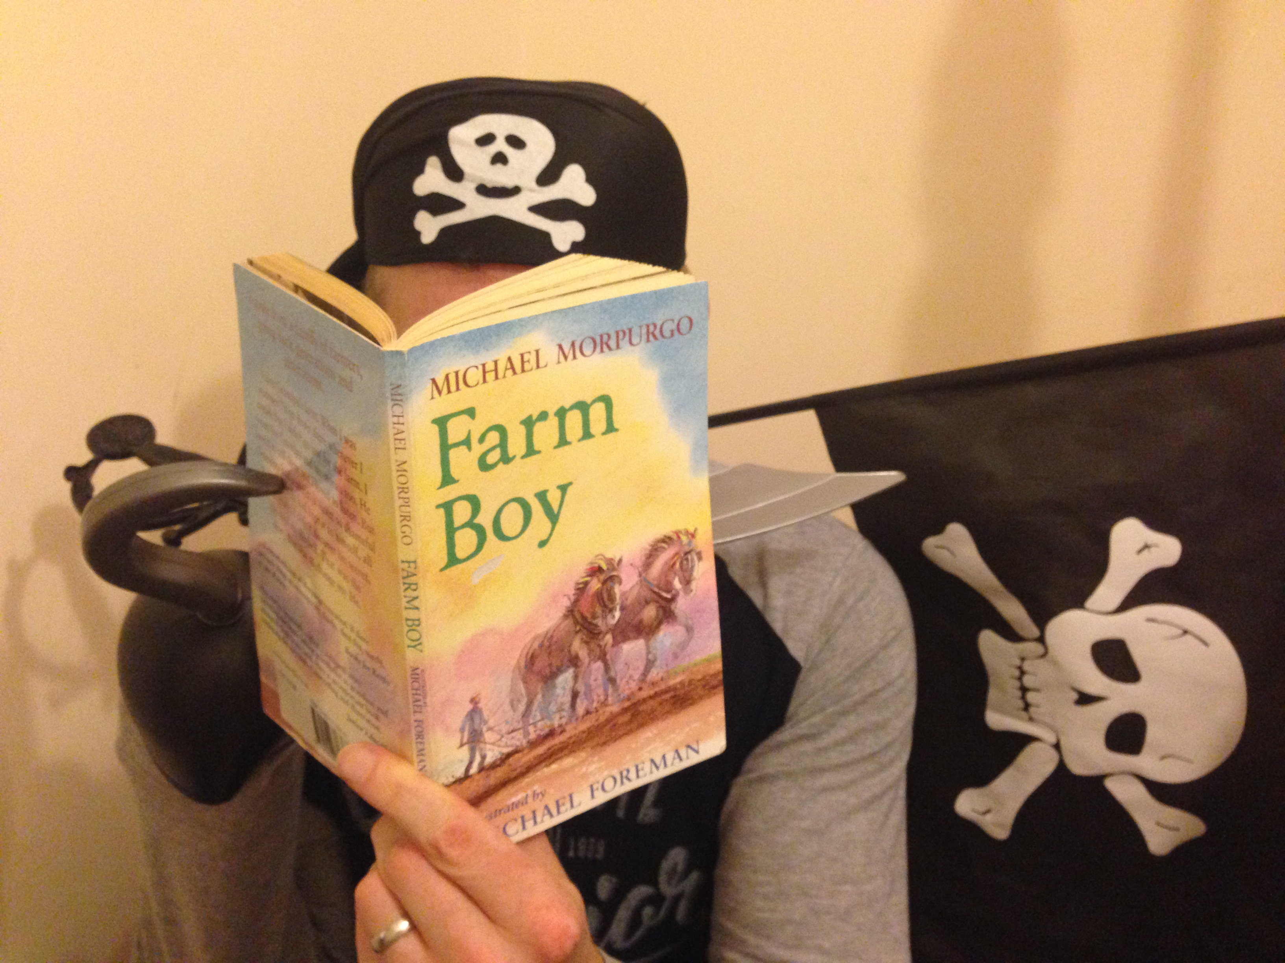
Farm Boy by Michael Morpurgo is my favourite children's book because it is exciting and also has an important message behind it - if you can be brave and believe in yourself then you can achieve amazing things.

Slide 12
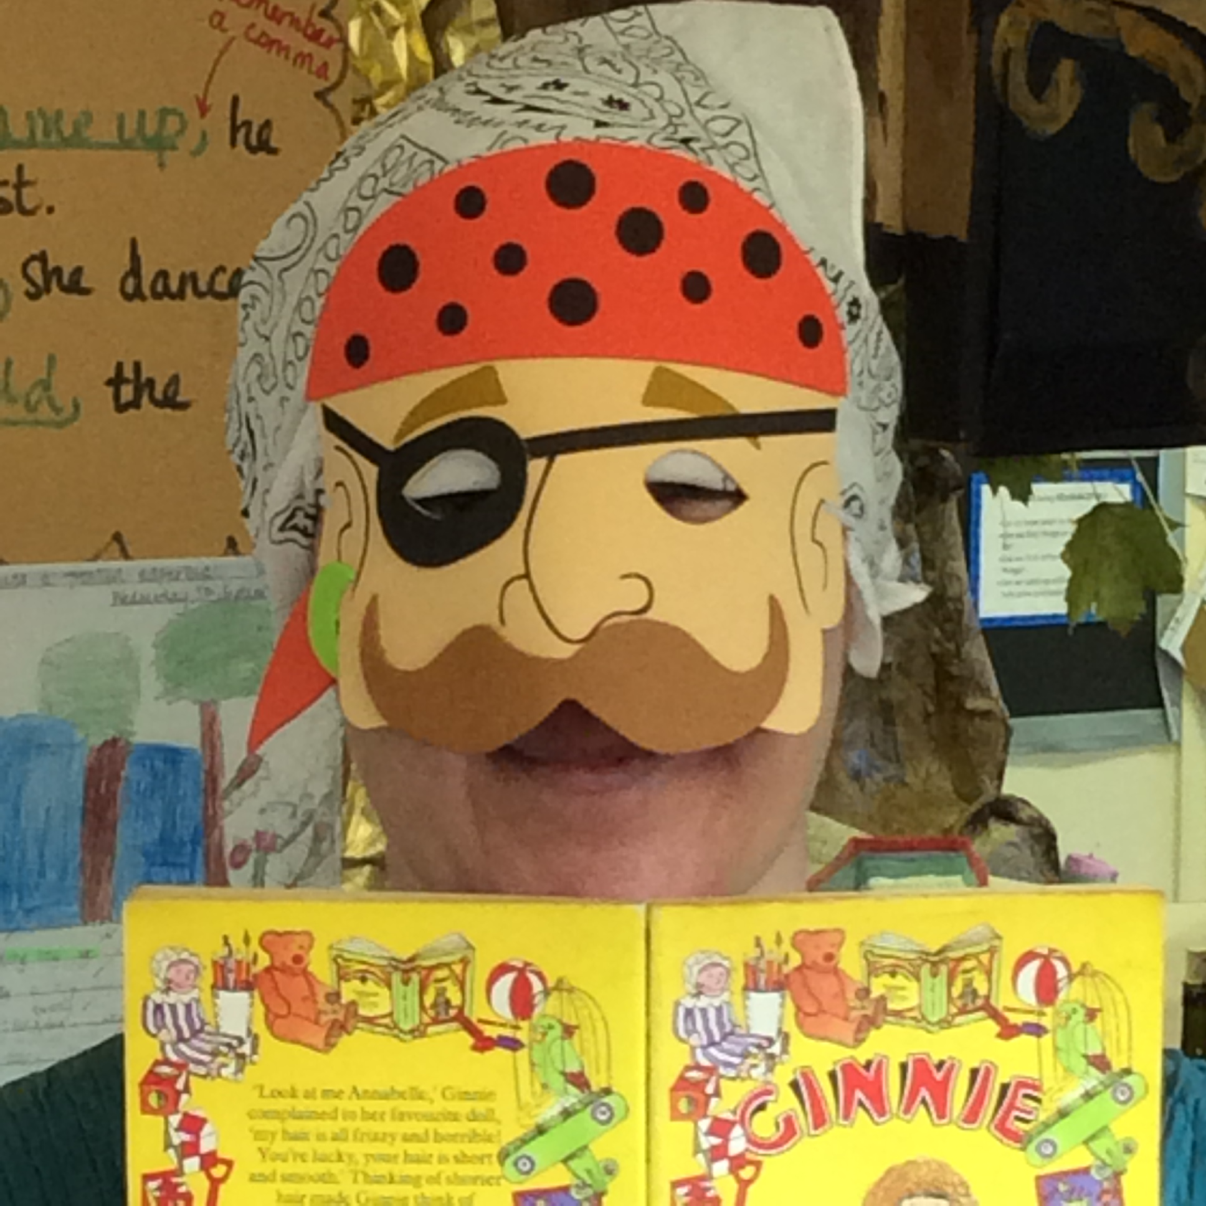
This book is from a series of short stories about a young girl called Ginnie who was a bit messy and disorganised………maybe like me? I had this book as a child and read it over 100 times.

Slide 13
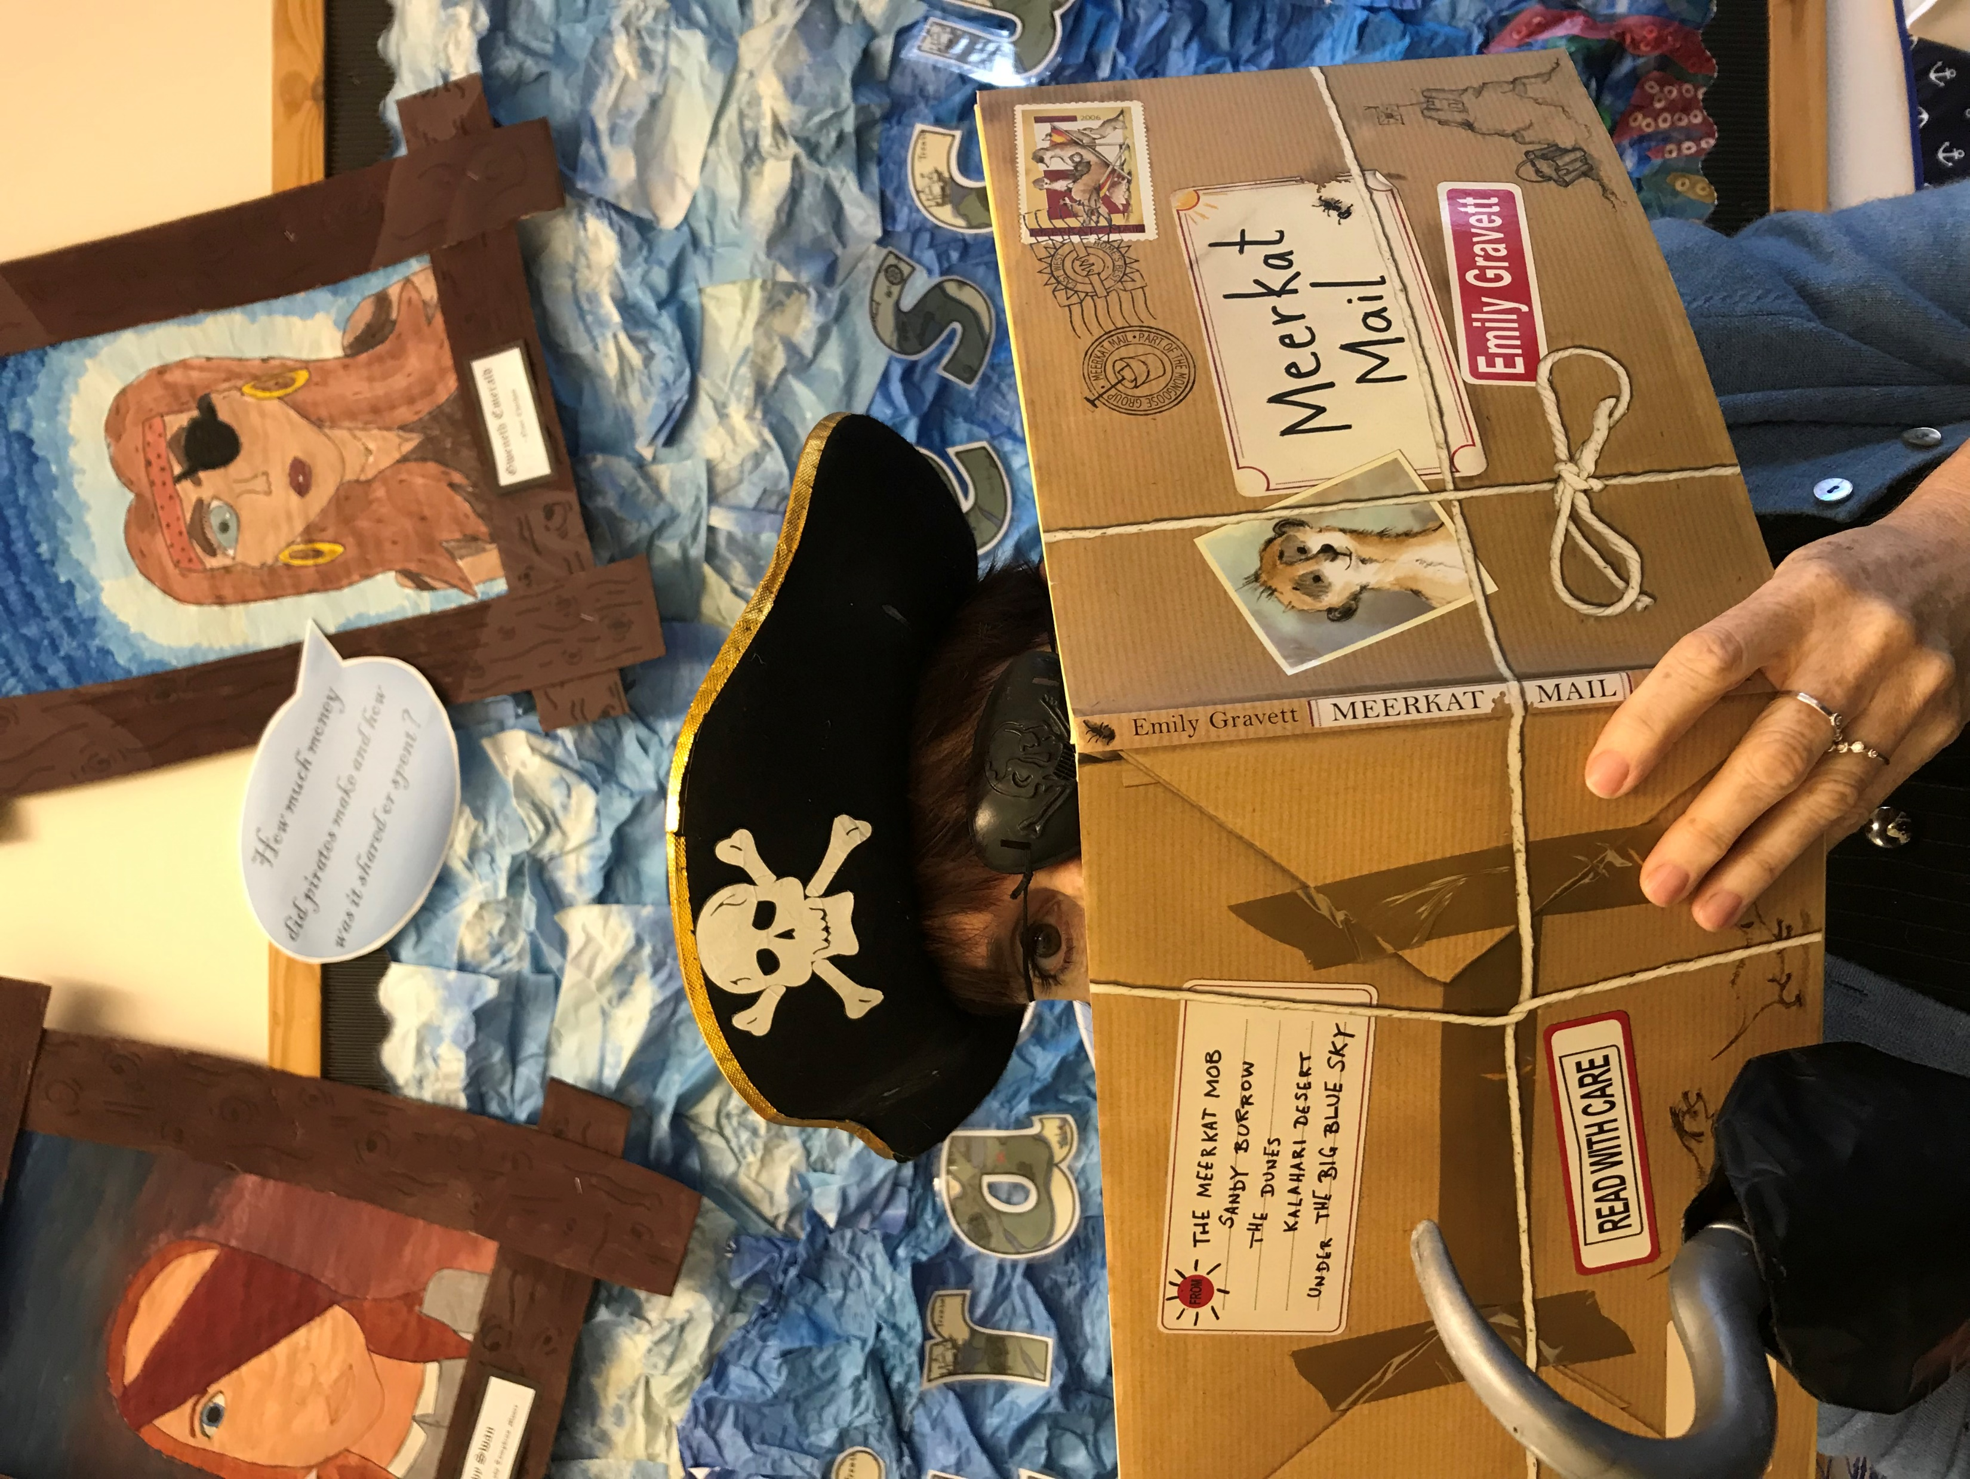
I love Meerkat Mail because I really like the little letters and cards – you can open them and read them. The letters and cards tell the story of Sunny’s travels as he explores the world trying to find the perfect place to be when he gets fed up of his family and friends…..

